Slide 1
MANAGING ORGANIZATIONAL POLITICS
By
Zacharys Anger Gundu, PhD
Dubai Leadership Summit, December, 2011

Slide 2

LEARNING OBJECTIVES
The meaning of organizational politics.
The Logic of organizational politics.
The Ethical question in organizational politics.
Knowing key players in the organization.
Knowing the landscape.
Knowing the rules.
Knowing and acquiring the winning tips.
We will get down the bus with these
Destination: Dubai Leadership Summit

Slide 3
INTRODUCTION
All organizations are political-whether on earth or in heaven.
You ignore this fact at your peril.
You also acknowledge this fact and participate in organizational politics at your peril.
Organizational politics underscores:
  How people are recruited.
  How work is done.
  Who does what.
  How people advance.
  How people leave the organization
Just like other political contexts, organizational politics is characterized by a binary tension.
At one end are those who see it as good and noble.
At another end, are those who see it as similar to war.

Slide 4

A VIEW FROM NEALE DONALD WALSCH
‘The person on the mountaintop did not get there by falling. You have to climb where you want to go- and you cannot get there by climbing over others.
It is about climbing with others. Side by side and even pulling some others up with you. If you are willing to do this, when you get to your destination, others will be happy you are there-which is what will keep you there’.
Neale Walsch: Author of Conversations with God.
In the clouds and on the mountain top

Slide 5
A VIEW FROM MACHIAVELLI
‘There are two ways to carry out a contest, The one by law and the other by force. The first is practiced by men and the other by brutes, and as the first is often insufficient, it becomes necessary to resort to the second.
It is not possible to find morality in the struggle for power.----In struggles for power, your judgment should be based entirely on self interest and finding as ----route to your goal as possible and if that route is bloody and barbaric so much the worse for those who oppose you’.
The Prince
The route can be bloody and barbaric

Slide 6
IS ORGANIZATIONAL POLITICS WAR?

Slide 7

WHAT IS ORGANIZATIONAL POLITICS?
Activities of managers aimed at increasing their power and pursuing goals that favour their individual and group interests.
Informal behaviours and acts of influence aimed at protecting and enhancing individual careers when conflicting courses of action are possible.
Definitions
It is all about the moves you make

Slide 8
CHARACTERISTICS OF ORGANIZATIONAL POLITICS
Indirect and informal communication.
Use of covert tactics to advance.
Manipulation.
Not offending the wrong people.
Courting attention.
Truth management.
Concealment of vulnerability.
Currying favours.
Scape goating
Passing the bulk.
Learning how to use others.
Can you recognize these
What is happening here?

Slide 9

THE LOGIC OF ORGANIZATIONAL POLITICS
Resources.
Allowances/salaries.
Budgets.
Staff.
Office and specks.
Benefits.
Positions.
Recognition.
Power and Influence.
Its all about competition
Aiming for the clouds!!!

Slide 10
THE UP SIDE OF ORGANIZATIONAL POLITICS
Necessary for career success.
Recognition of talents.
Enhance leadership.
Promote change.
Causes realignment and power shift.
Influence on decisions.
Use of power and control of people to achieve organizational goals.
Promotes debate.
What organizational politics could mean to you.
The run for the top

Slide 11
THE DOWN SIDE OF ORGANIZATIONAL POLITICS
Can effect the organization adversely.
Can ruin otherwise brilliant careers.
Can generate conflicts.
Polarization of an organization.
Promote mediocrity.
Lead to loss of morale.
The Organization and its members can loose out.
Defeat and Loss can Result

Slide 12
THE ETHICAL PARADOX
If it is not advantageous, do not act.
If it is not attainable, do not employ troops.
If it is not in danger, do not do battle.
Victory is the general’s goal, do not engage in military activity if no benefit will accrue from it.
What is the utility of the action?.
How does the utility balance out any harm it will do to others and the organization?.
Does the action conform to standards of equity and justice?
SUN TZU: The Art of War.
Determination of Ethical action.

Slide 13
KNOWLEDGE OF THE LANDSCAPE
‘In spread out ground do not encamp.
In junction ground join with allies
In crossing ground do not linger
In enclosed ground strategize
In death ground do battle’.
The landscape dictates the actions you take. Every activity takes place on a certain ground, every ground suggests the response appropriate to it.
The challenge is to know the political landscape of your organization and let this guide your actions.
SUN TZU: The Art of war.
The Lesson.

Slide 14
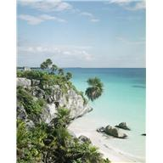
THE LANDSCAPE
Knowledge of the landscape includes:
  Knowing the key players.
  Knowing the ground and knowing the rules.
Knowing the key players will lead you to successful alliances.
You will also know who not to offend.
Knowing the ground will help you in the actions you choose.
While knowing the rules will help you to survive .
Importance of Knowledge
The landscape can be many things

Slide 15
THE KEY PLAYERS
The Boss: The person in charge.
The ‘Yes man’: Agrees with the boss even when he/she is wrong.
The Maverick: Non conformist and a possible window to change.
The Traitor; Talks less and undermines people at their back.
The Vortex: Always pushing for their personal agenda.
The Empire builder: Getting more people into their debt and expanding their influence.
The Peace maker: Always concerned with harmony.
The Brain: Smart, data driven.
The Parrot: Steals ideas and parrots the right opinions of the day.

Slide 16
THE GROUND
‘One skilled at moving the enemy. Forms and the enemy must follow. Offers and the enemy must take. Move them by this and await them with troops’
Do not fight the enemy head on. Shape their ground. This will narrow their course of action, leading them to where you want. They have no alternative if the offer is made from the perspective of victory. They choose it as if it were their own idea. This is skill.
SUN TZU: The Art of war.
The Lesson.

Slide 17
ORGANIZATIONAL GROUND.
This consists of :
The formal hierarchy: Comprising the reporting structure and who works for whom.
The informal hierarchy: Runs parallel to the formal one. Comprises people with power and gatekeepers. Some of these know the office gossip while others may control the schedule of the boss. Some of these may even be outside the organization.
Alternative hierarchy: Dotted line reporting where the individual has more than one boss. The dotted line boss can be an invaluable ally if your interests are aligned.

Slide 18
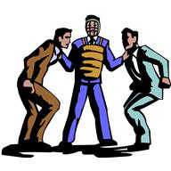
IDENTIFYING THOSE WHO HAVE POWER
These are managers who can intercede favorably when one is in trouble.
They can get approvals for expenditures beyond budget.
They are able to get items on the agenda at important meetings.
The have formal and informal access to decision makers at short notice.
They have influence with decision makers.
How to know them
They can also knock heads for effect

Slide 19
THE FIRST LAW OF POWER
‘Never outshine the Master.’
‘Always make those above you feel comfortably superior. In your desire to please or impress them, do not go too far in displaying your talents or you might accomplish the opposite-inspire fear and insecurity. Make your masters appear more brilliant than they are and you will attain the heights of power.’ Robert Green: The 48 Laws of Power.

Slide 20
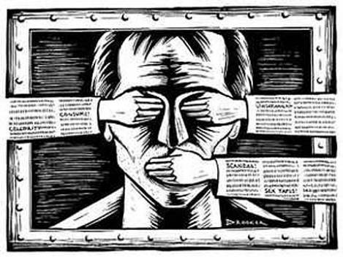
TWO VIEWS ON RULES
‘Keep your mouth shut, open your eyes and do what you are told’.
‘Before you can command, you must learn how to obey. Never keep a subordinate who has not learnt how to obey- no matter how competent he is-especially if he is competent.’
The Mafia Manager
See no evil, speak no evil, hear no evil

Slide 21

TIMING: SUN TZU
‘There is a season for setting fires. There are days for starting fires. The season is when heaven is dry. The days are when the lunar mansion is the winnowing basket, the wall, the winds and the chariot platform. All four lunar mansions are days when the wind rises.’
Employ fire only when events support it and conditions are auspicious.
SUN TZU: The Art of War.
The Lesson.

Slide 22
TIMING: THE BIBLE
To every thing there is a season, a time for every purpose under heaven: A time to be born and a time to die, a time to plant and a time pluck what is planted---’.
Know the seasons and align with them.
Ecclesiastics Chapter 3
The Lesson

Slide 23
TIMING: ROBERT GREENE
‘Never seem to be in a hurry- hurrying betrays a lack of control over yourself, and over time. Always seem patient as if you know everything will come to you eventually. Become a detective of the right moment, sniff out the spirit of the time, the trends that will carry you to power. Learn to stand back when the time is not yet ripe, and to strike fiercely when it has reached fruition’. The 35th Law of Power.

Slide 24
USEFUL RULES
Be friendly to everyone-and do not join issues you are not clear about.
Be patient.
If your neighbor gets up early, get up earlier.
Give help only when it profits you or your interest.
If you go out of the formal rule book, do not get caught.
If you make an example of any one, make sure every one knows.- Punish one, teach a hundred.
If you stumble, it will be on a stone and not a mountain.

Slide 25
USEFUL RULES (Cont)
Stay late and check your work.
Do not let others see you ‘sleeping’ on duty.
If the boss is out of the office, commit to working harder.
Its not about who is in charge but who takes charge.
Control your story before others do.
Do not burn your bridges as you climb up.
Shake hands when you are parting.
Be a good team player.
More useful rules
Shake hands and be a good team player

Slide 26
WINNING TIPS
Get to know your colleagues.
Spread the credit.
Be generous with help.
If a boss or co worker has to miss a meeting, offer to stand in.
Do not be afraid to take on unpopular projects: If you succeed, you are instantly a star- if you do not, no one thought it was possible.
Do not think you do not have competitors. They will always be around you.

Slide 27
WINNING TIPS (Cont)
Do not miss an opportunity to contribute- your superiors are listening.
Seek out a mentor: Pay attention to how they communicate. ‘Break’ into his/her network of relationships and grow in their shadow.
Analyze the sources of power in the organization.
Develop a personal power base to increase your visibility and individual power.
Learn to use effective power tactics (like consultation)
Avoid power tactics that tend to backfire (like coercion).
Master the different ways of managing impressions.

Slide 28
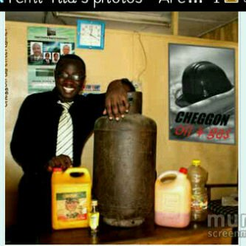
MANAGING IMPRESSIONS
Impressions are managed through:
  Legitimacy.
  Persuasion.
  Consultations.
  Ingratiation.
  Pressure
  Coalitions.
  Exchange
The aim is to tell your story using your words and actions to improve your image. It is self promotion.
Impressions are very important
I am in the oil and gas business

Slide 29
CLOSING REMARKS
Organizational politics is real and cannot be ignored.
It can speed your way to the top, but can also ruin your career if you are not careful.
It can bring rancor in the organization and even ruin.
It’s a two edged sword that has to be handled very carefully.
It is based on similar principles guiding political conduct and even war.

Slide 30

THE END

